Slide 1

Online Quiz portal
Test Your Knowledge

Slide 2
Presented By:
Batch-99 API
Chethan Nagaraju - 6624
Raju Bhashabathini - 6611

Slide 3
CONTENTS:
Introduction
Problem statement
System Design
Technology
Results
Future Enhancements

Slide 4
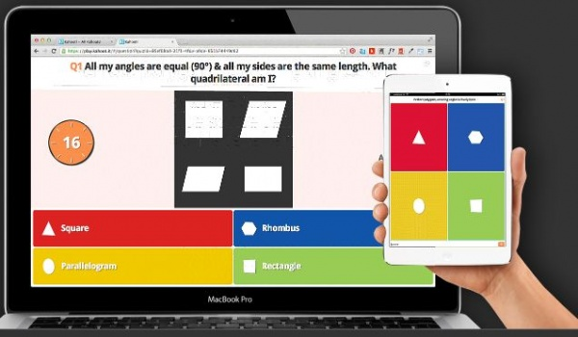
INTRODUCTION
Quizzes can be used as a brief assessment in education and similar fields to measure growth in knowledge, abilities, or skills.
This application helps the user to test their knowledge. Since Smartphone mobiles are being widely used by general population and students, the Quiz Contest application can provide on the Student's mobiles and laptops.
We use this quiz application to test the Knowledge of Freshers or new joinee to the company.

Slide 5
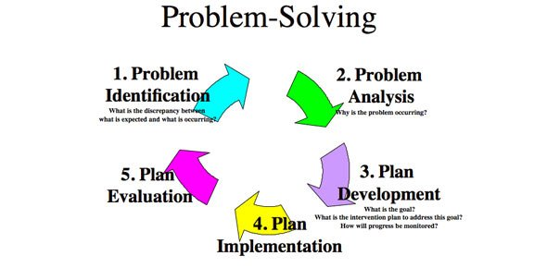
PROBLEM STATEMENT
In the past days students or other peoples had to purchase Study Materials or Question Banks to practice the tests which is inconvenient as money and paper are wasted.
Students may fail or score less if they directly write the exam without testing themselves.

Slide 6
SYSTEM DESIGN
Subjects
Browser
HTML
CSS
Start Quiz
Online Quiz Portal
New User Old User
Docker
Registration
Login
Angular
JS
Result
AWS

Slide 7




Technologies
CSS 3
Angular Framework
HTML 5
Bootstrap
MYSQL
Node JS

Slide 8
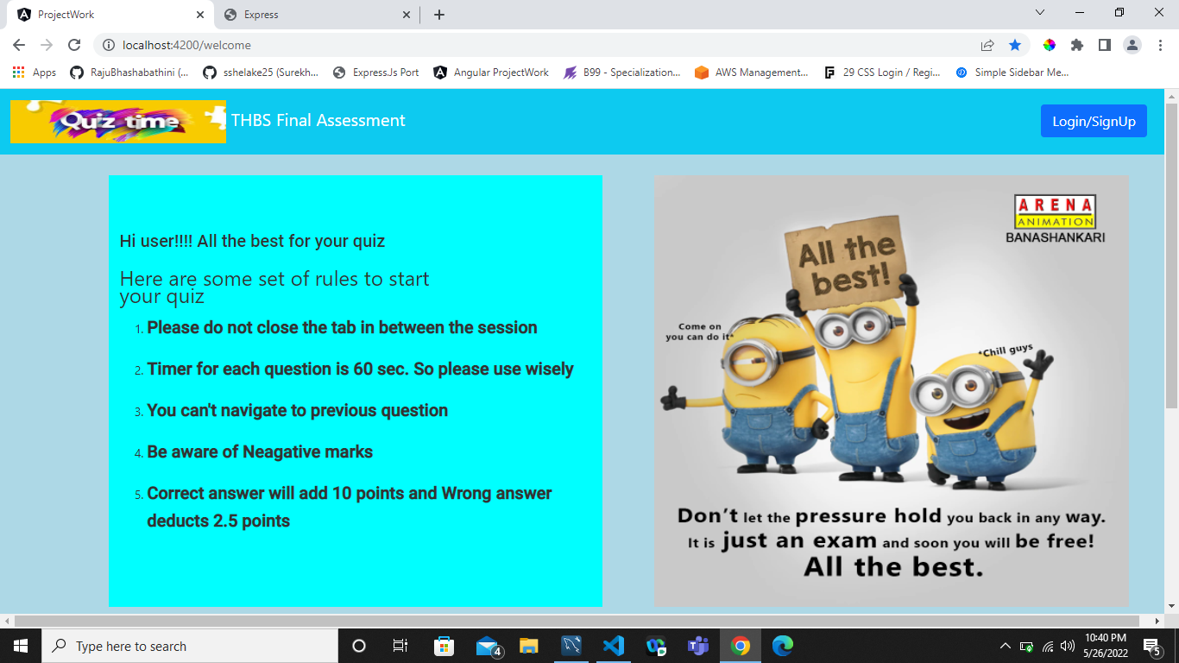
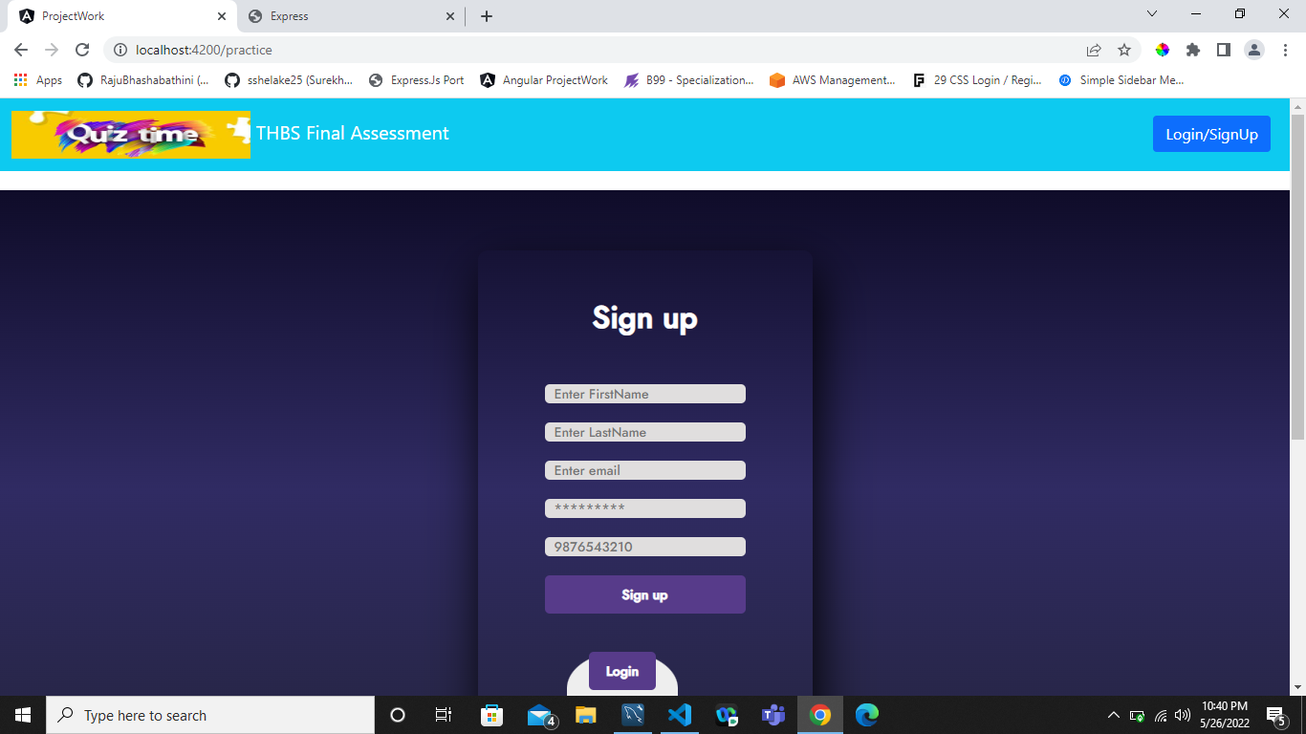

Slide 9
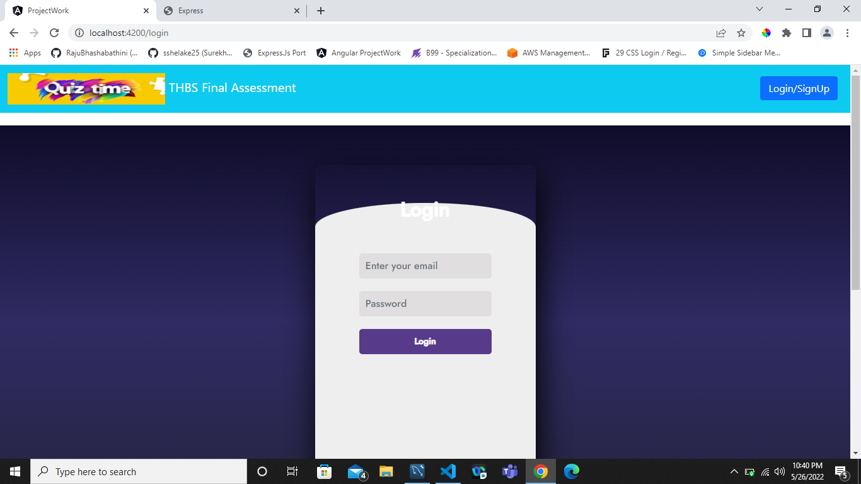
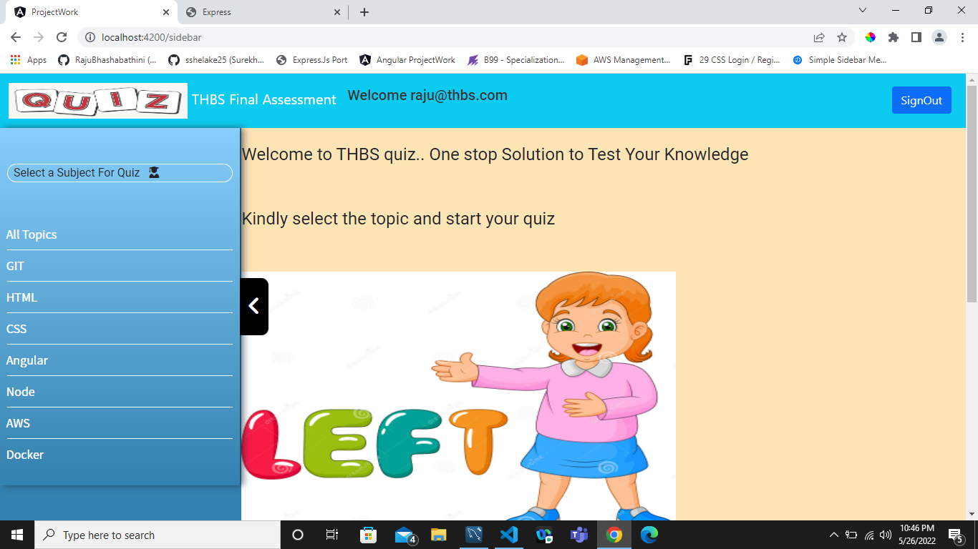

Slide 10
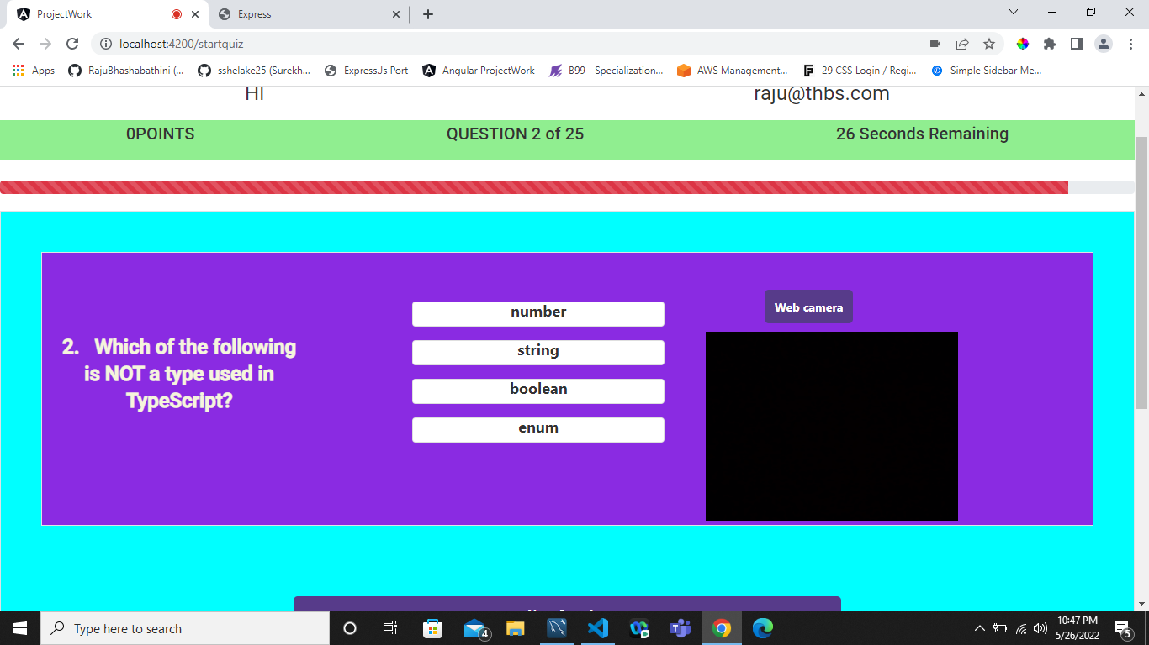
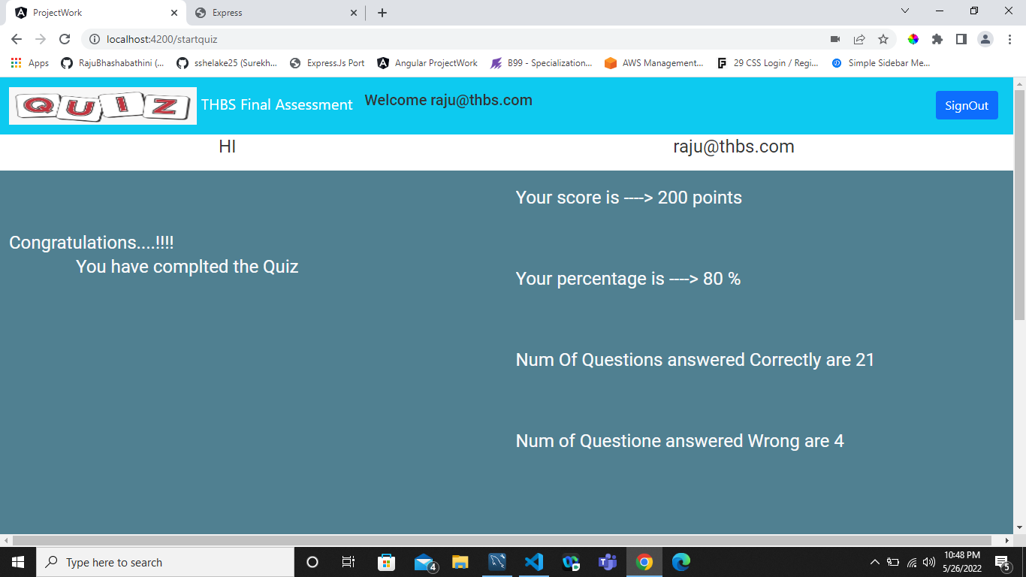

Slide 11

FUTURE ENHANCEMENT
By using Advance the software in future, we can include more facilities like online job portal and add more Subjects.
We can Record the Test session and watch later whenever required.
By using artificial intelligence we reduce the malpractice

Slide 12

Any Queries??

Slide 13
Thank You

